Slide 1

I
Structural Pattern
Facade Pattern

Slide 2
Facade Pattern
Intent
Provide a unified interface to a set of interfaces in a subsystem. Facade defines a higher level onterface that makes the subsystem easier to use.
Also Known As
Facade

Slide 3
Facade Pattern
Applicability
Use the Facade pattern when:
Want to provide a simple interface to a complex subsystem. Subsystems often get more complex as they evolve. Most patterns, when applied, result in more and smaller classes. This makes the subsystem more reusable and easier to customize, but it also becomes harder to use for clients that don’t need to customize it. A facade can provide a simple default view of the subsystem that is good enough for most clients. Only clients needing more customizability will need to look beyong the facade.
There are many dependencies between clients and the implementation classes of an abstraction. Introduce a facade to decouple the subsystem from clients and other subsystem, thereby promoting
Want to layer your subsystem. Use a facade to define an entry point to each subsystem level. If subsystems are dependent, then you can simplify the dependencies between them by making them communicate with each other solely through their facades.

Slide 4
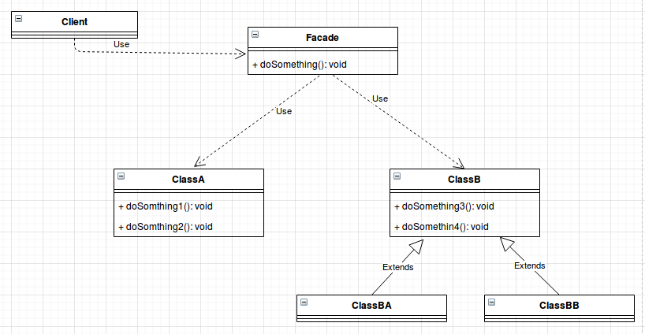
Facade Pattern
Structure

Slide 5
Facade Pattern
Participants
Facade
Knows which subsystem classes are responsible for a request.
Delegates client requests to applopiaar
Subsystem classes
Implement subsystem functionality
Handle work assigned by the Facade object.
Have no knowledge of the facade. That is , they keep no references to it.

Slide 6
Facade Pattern
Collaborations
Related Patterns
Clients communicate with the subsystem by sending requests to facade, which forwards them to the appropriate subsystem object(s). Although the subsystem objects perform the actual work, the facade may have to do work of its own to translate its interface to subsystem interfaces.
Clients that use the facade don’t have to access its subsystem objects directly.
Abstract Factory
Mediator
Singleton

Slide 7
Facade Pattern
Consequences
The Facade pattern offers the following benefits:
It shields clients from subsystem components, thereby reducing the number of ubjects that clients deal with and making the subsystem easier to use.
It promotes wak coupling between the subsystem and its clients. Often the components in a subsystem are strongly coupled. Weak coupling lets you vary the components of the subsystem without affecting its clients.
It doesn’t prevent applications from using subsystem classes if they need to. Thus you can choose between ease of use and generality.

Slide 8
Facade Pattern
Known Uses
Compiler example in the sample
In the ET++ application framework, an application can have build in browsing tools for inspecting its objects at runtime. These browsing tools are implemented in a separate subsystem that includes a facade classes called “ProgrammingEnvironment”.
The Choices operation system [CIRM93] uses facades to compose many frameworks into one. The key abstractions in Choices are processes, storage and address spaces.

